Slide 1
PREsent03 - Spring
Account : ducha5

Slide 2
Content
How to integrate Spring and Hibernate Frameworks ?
Spring MVC Interceptor

Slide 3
How to integrate Spring and Hibernate Frameworks ? (work with hibernate 5)
Step 1 : Create maven project and add dependencies Spring and Hibernate .
Step 2 : Config and create bean : dataSources,

Slide 4
Step 1 : Create maven project and add dependencies Spring and Hibernate
spring-core
spring-context
spring-orm
spring-tx
hibernate-entitymanager
hibernate-core
mssql-jdbc

Slide 5
Step 2 : Config Hibernate
Create bean data sources (driver, url, usename, password)
Create sessionFactory have 3 property (dataSource, packagesToScan, hibernateProperties).
Enable transactionManager and create bean transactionManager to auto manager transactional (optional) .

Slide 6
Create bean data sources (driver, url, usename, password)
<!-- DataSourse -->
<beans:bean id="dataSource"
class="org.springframework.jdbc.datasource.DriverManagerDataSource">
<beans:property name="driverClassName" value="${driver}" /> <-- driver -->
<beans:property name="url" value="${url}" /> <-- url -->
<beans:property name="username" value="${username}" /> <-- username-->
<beans:property name="password" value="${password}" /> <-- password-->
</beans:bean>

Slide 7
Create sessionFactory
<beans:bean id="sessionFactory"
class="org.springframework.orm.hibernate5.LocalSessionFactoryBean">
<beans:property name="dataSource" ref="dataSource" /> <!-- Dependency Injection -->
<!-- <property name="packagesToScan" value="com.fa.entities" /> <-- packages contant entities -->
<beans:property name="hibernateProperties">
<beans:props>
<beans:propkey="hibernate.dialect">org.hibernate.dialect.SQLServer2008Dialect</beans:prop>
<beans:prop key="hibernate.show_sql">true</beans:prop>
<beans:prop key="hibernate.hbm2ddl.auto">update</beans:prop>
</beans:props>
</beans:property>
</beans:bean>

Slide 8
Enable transactionManager and create bean transactionManager
<!-- enable the transaction support -->
<tx:annotation-driven transaction-manager="transactionManager" />
<!-- create the transaction support -->
<beans:bean id="transactionManager"
class="org.springframework.orm.hibernate5.HibernateTransactionManager">
<beans:property name="sessionFactory" ref="sessionFactory" /> <!-- DI -->
</beans:bean>

Slide 9
Spring interceptor
Spring Interceptor are used to intercept client requests and process them. Sometimes we want to intercept the HTTP Request and do some processing before handing it over to the controller handler methods. That’s where Spring MVC Interceptor come handy.

Slide 10
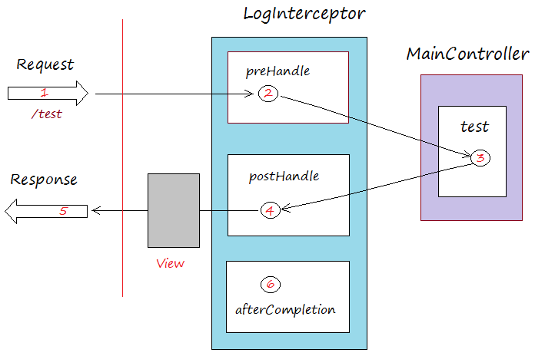
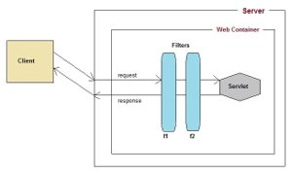
Compare interceptOr and filter
Interceptor
Filter

Slide 11
How to use interceptor
Must implement the HandlerInterceptor interface.
This interface contains three main methods:
prehandle() – called before the actual handler is executed, but the view is not generated yet
postHandle() – called after the handler is executed
afterCompletion() – called after the complete request has finished and view was generated

Slide 12
Thank for watching

